Slide 1

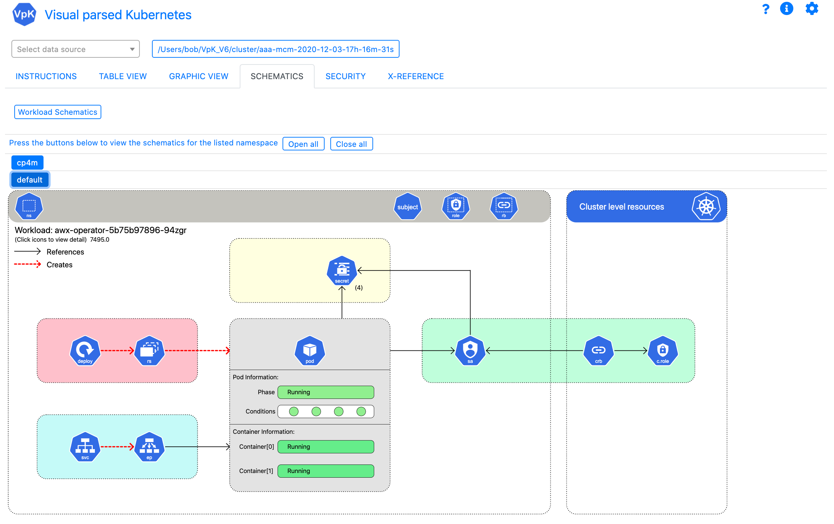
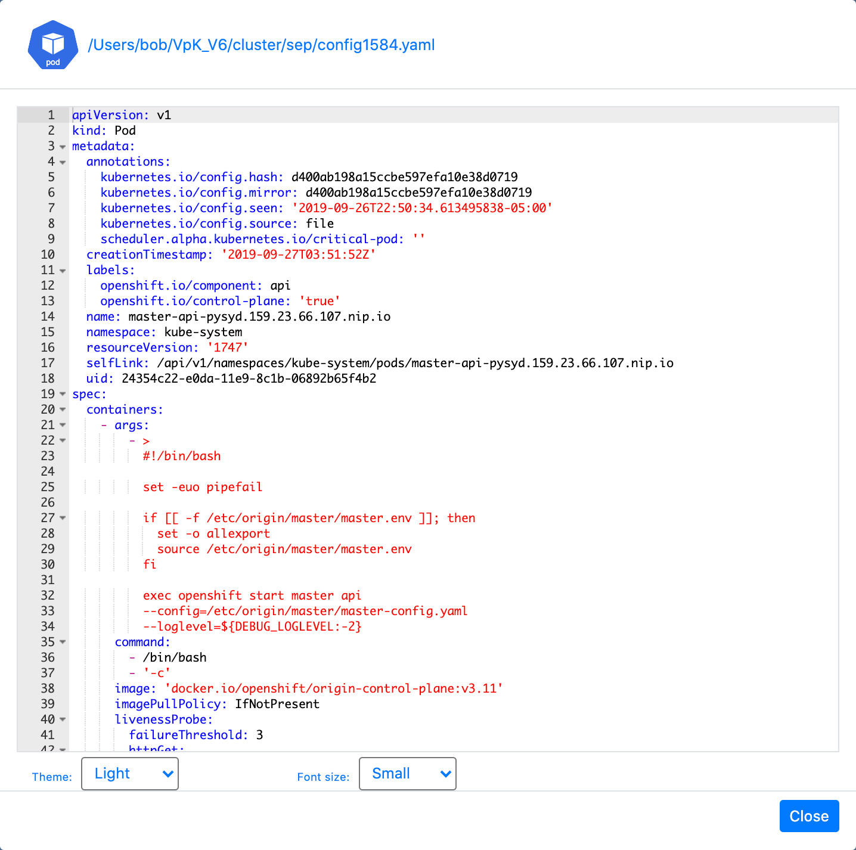
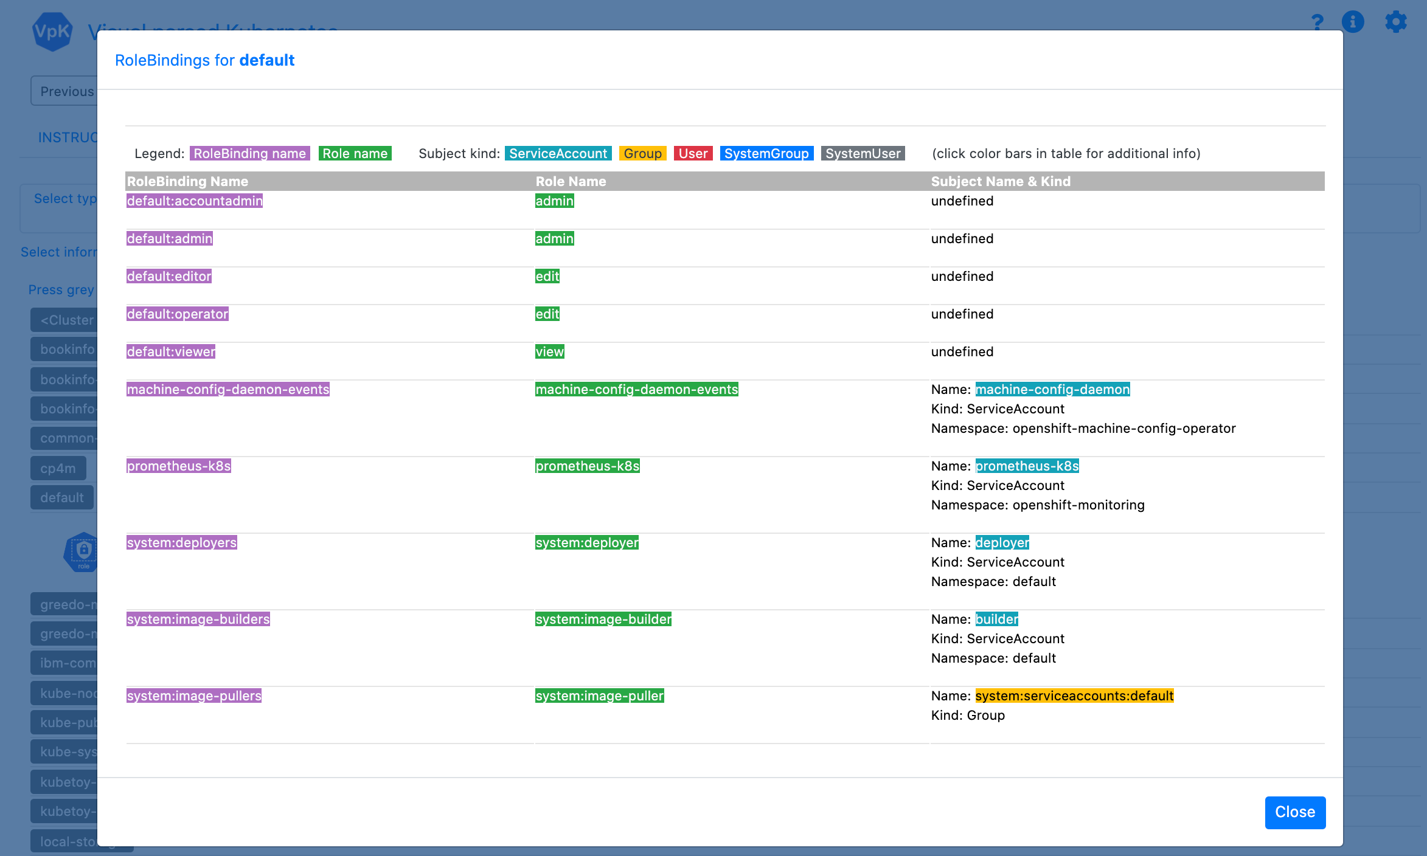
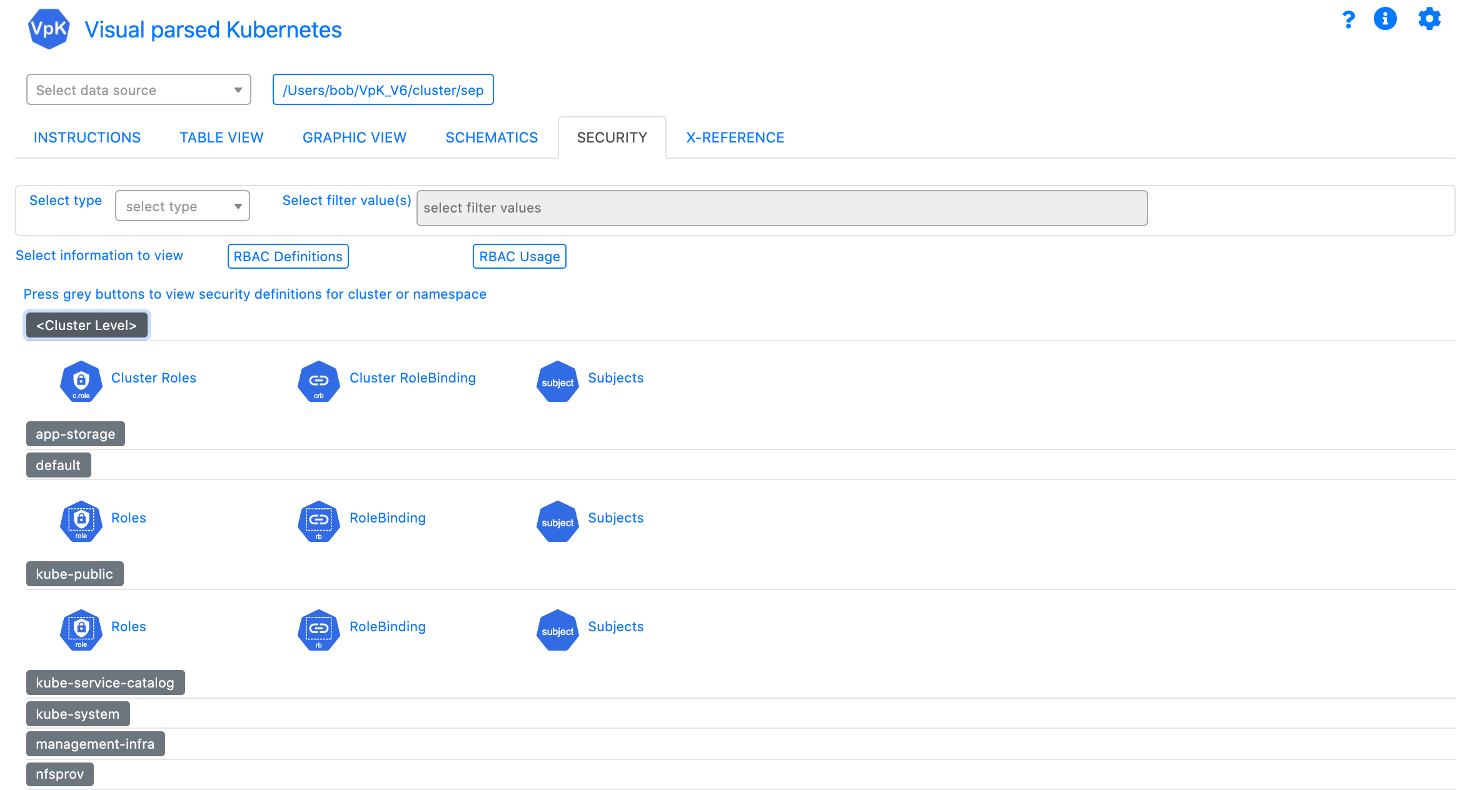
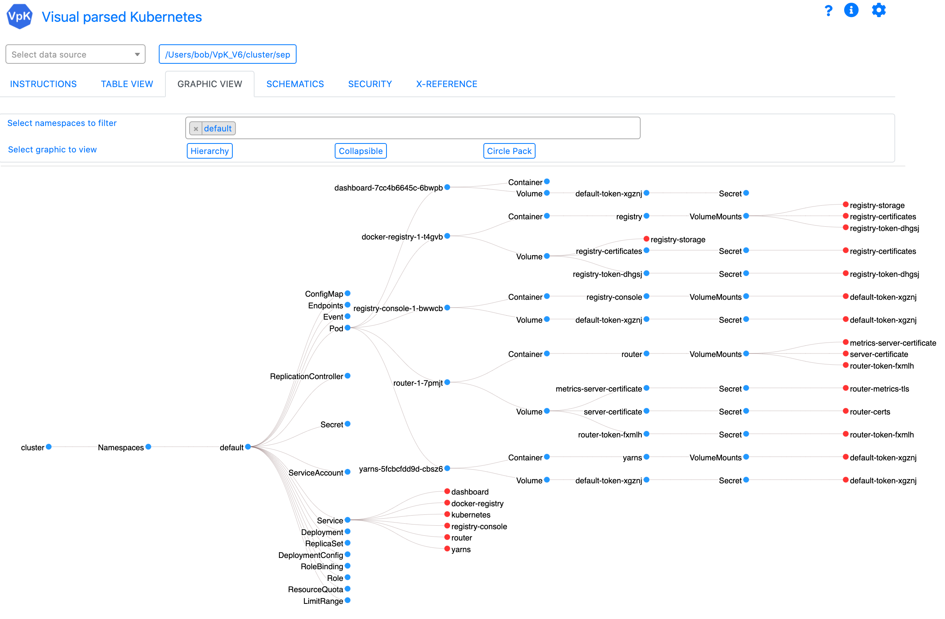
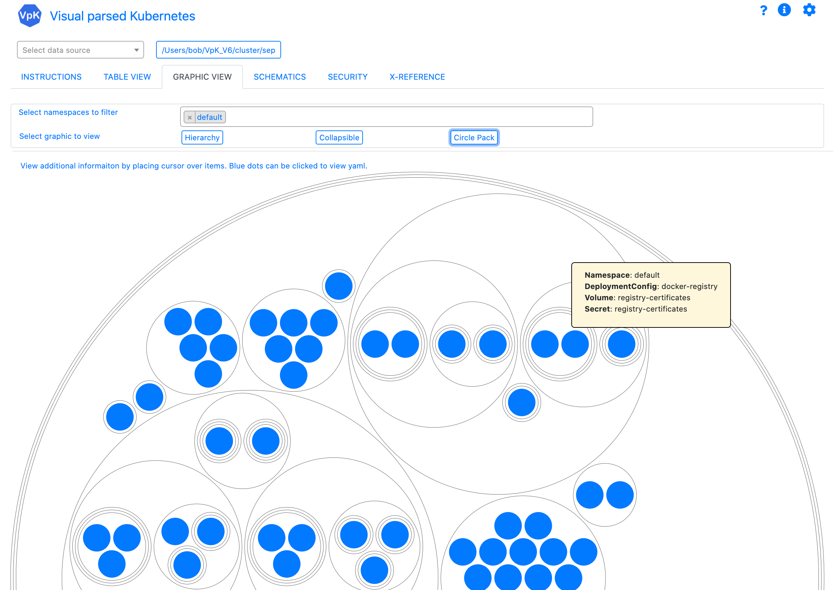
VpK Training
Overview

Slide 2
VpK
Visual parsed Kubernetes
“Visualizing what’s inside of Kubernetes”

Slide 3



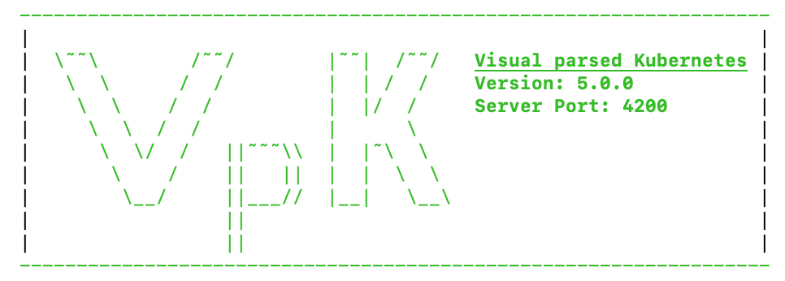

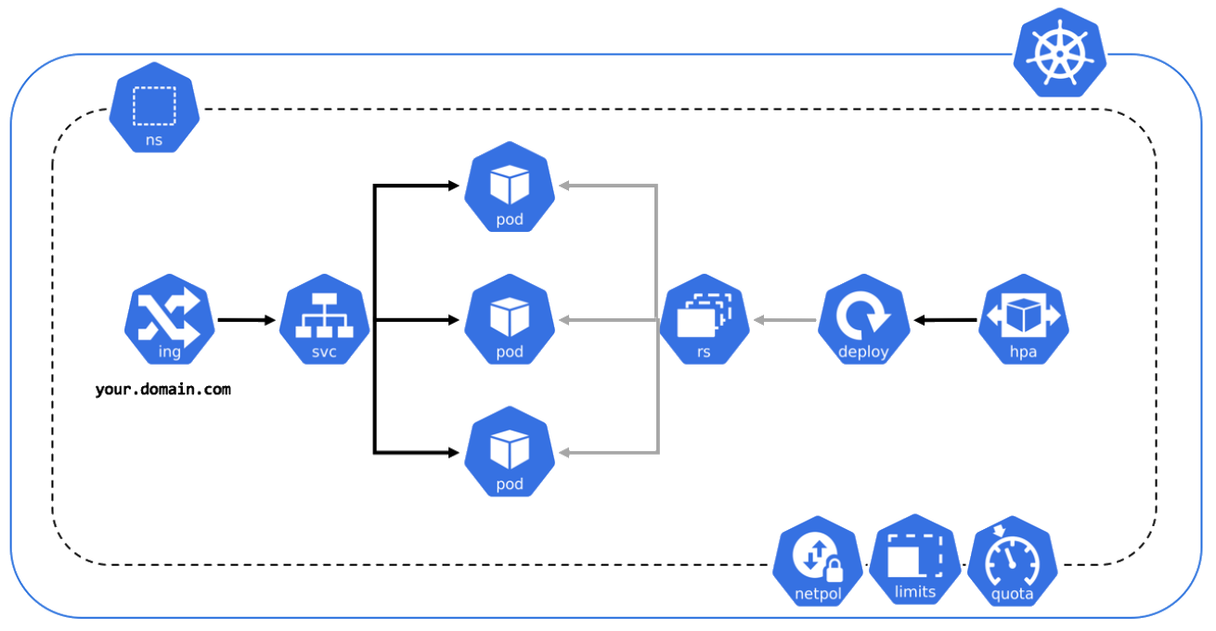

Overview
Visual parsed Kubernetes
Kubernetes
Application UI
Laptop

Slide 4
Overview
VpK is designed to capture a point-in-time snapshot of the cluster.
Vpk provides the ability to view the captured snapshot in a disconnected fashion. Once the snapshot is created the user no longer needs to be connected to the cluster.
Vpk will not modify a cluster. It is designed as read-only.
VpK is not a real time monitoring tool.

Slide 5
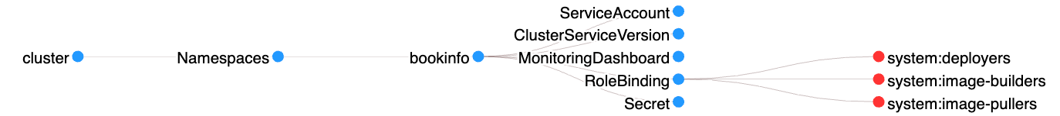

General usage, “click it”
If you see an icon, click it.
If you see text with colored background, click it.
If you see a blue dot or red dot in a graphic, click it.
If you see resource name in a table, click it.

Slide 6
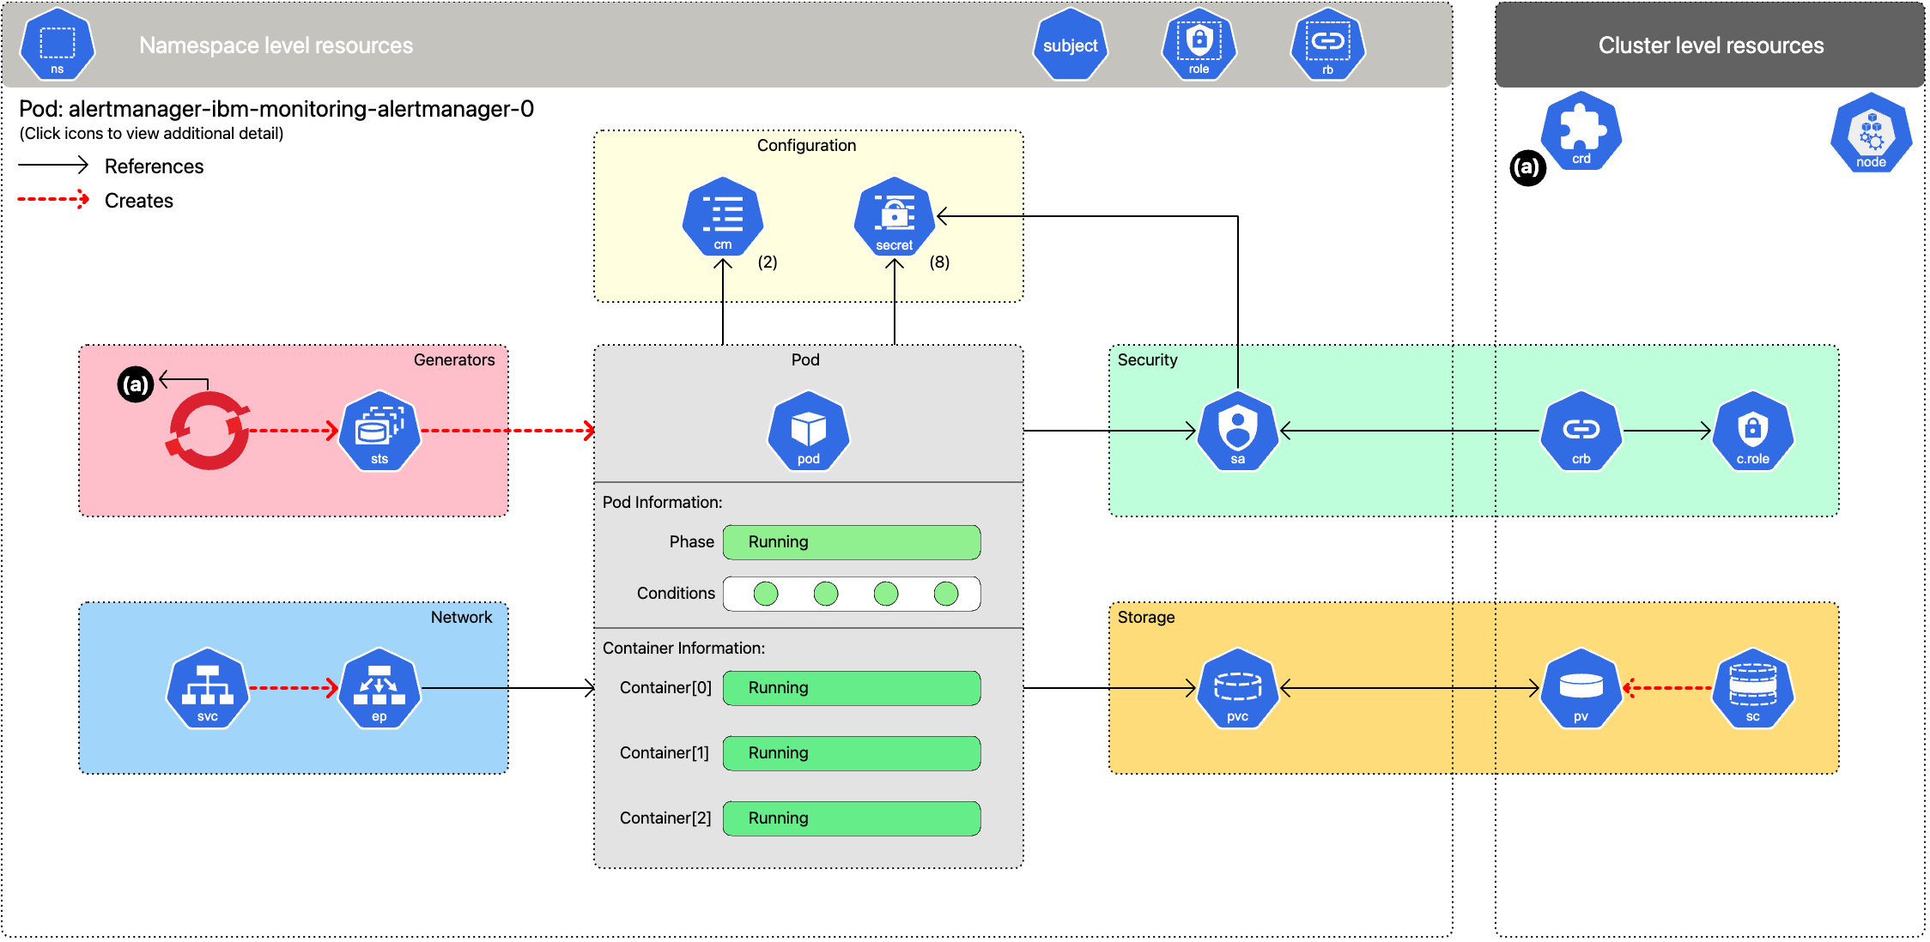
Interactive schematic of deployed workload

Slide 7
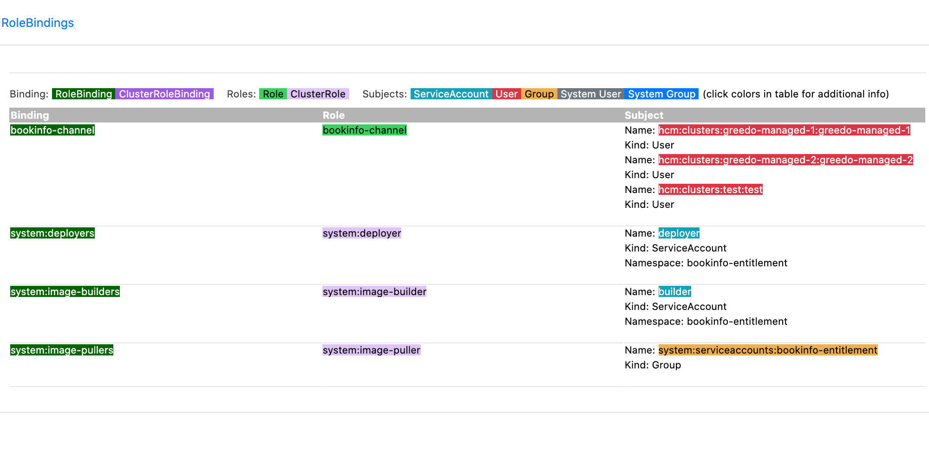
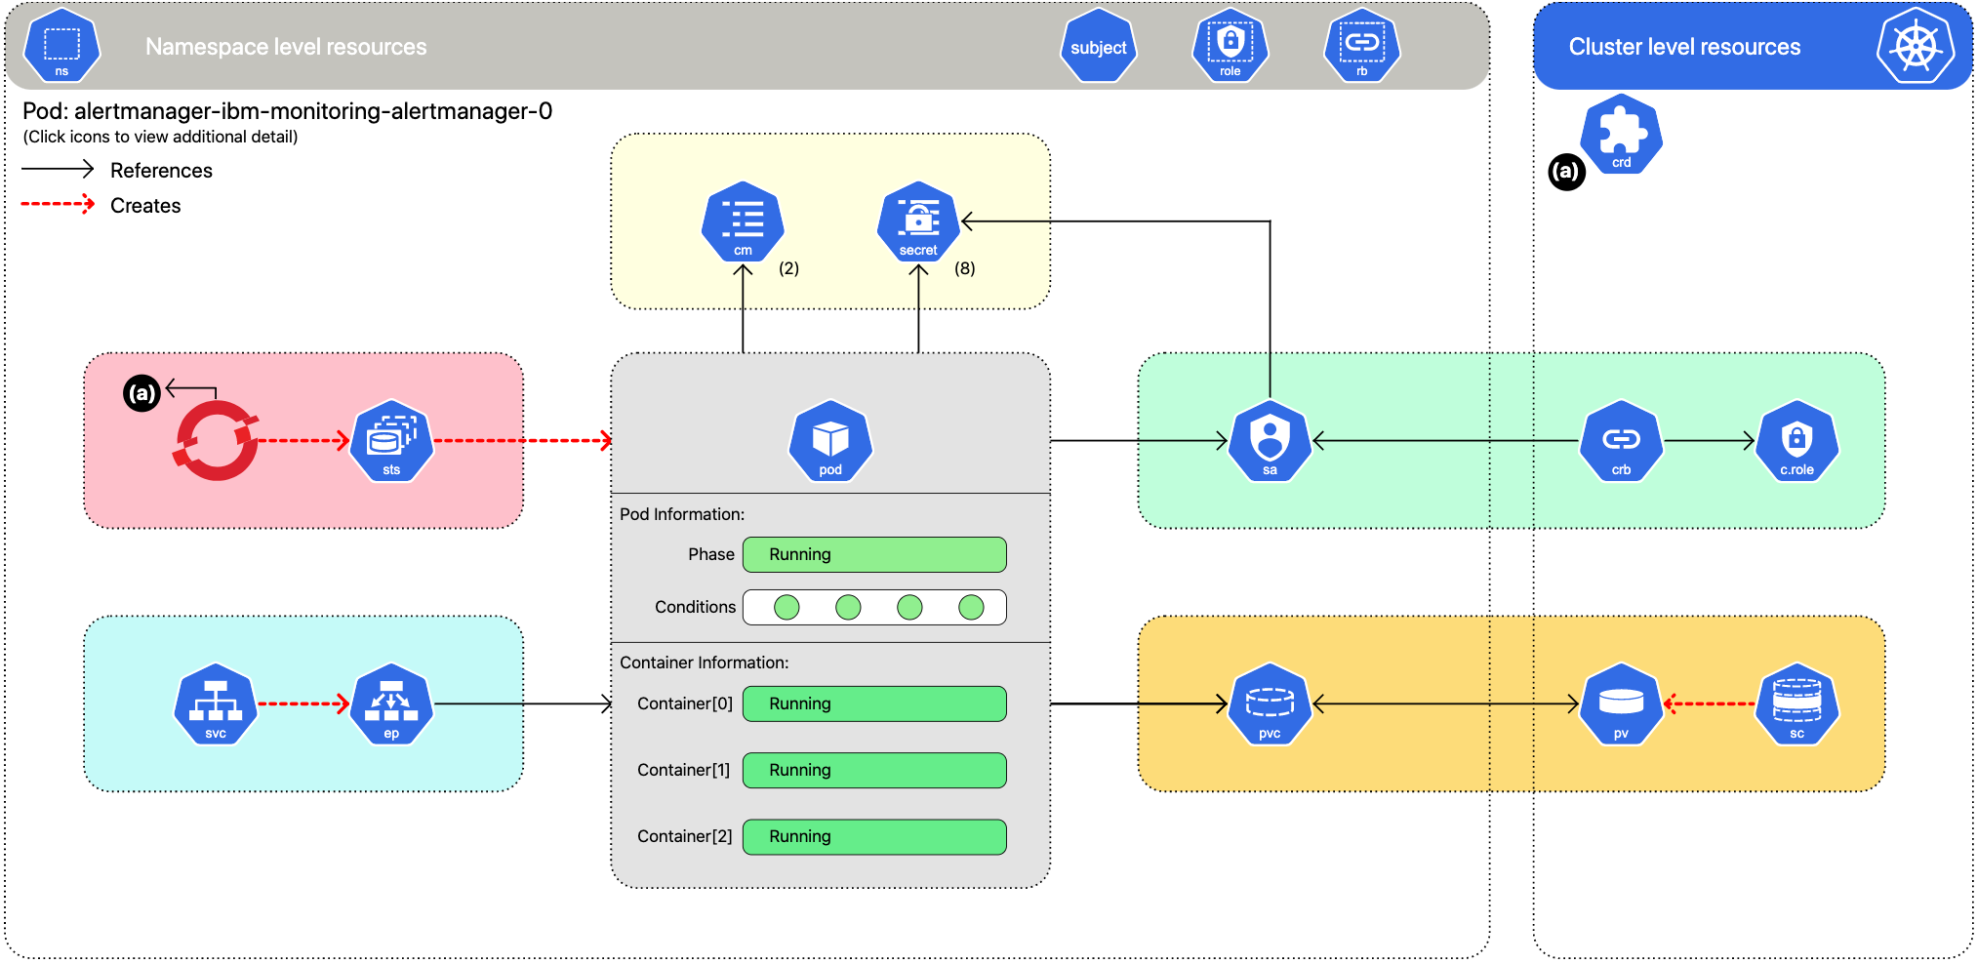
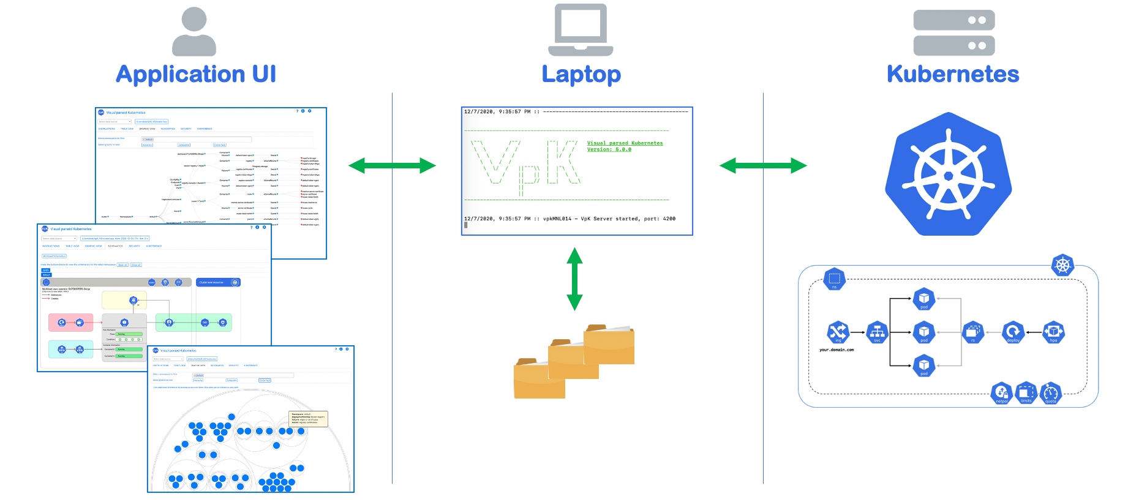
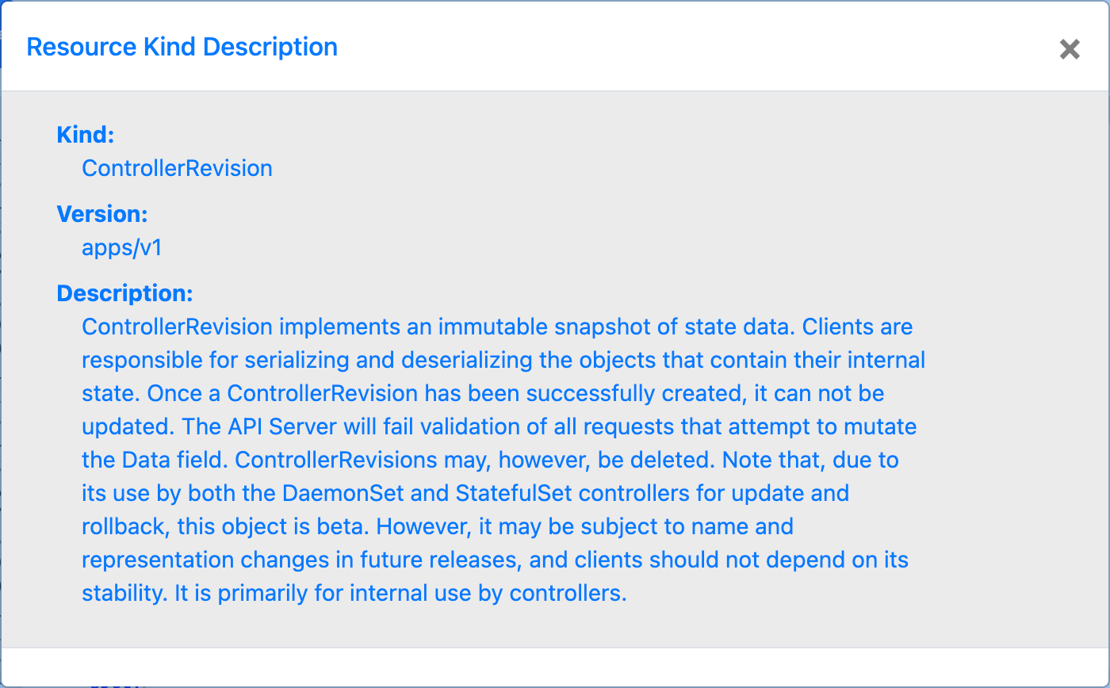
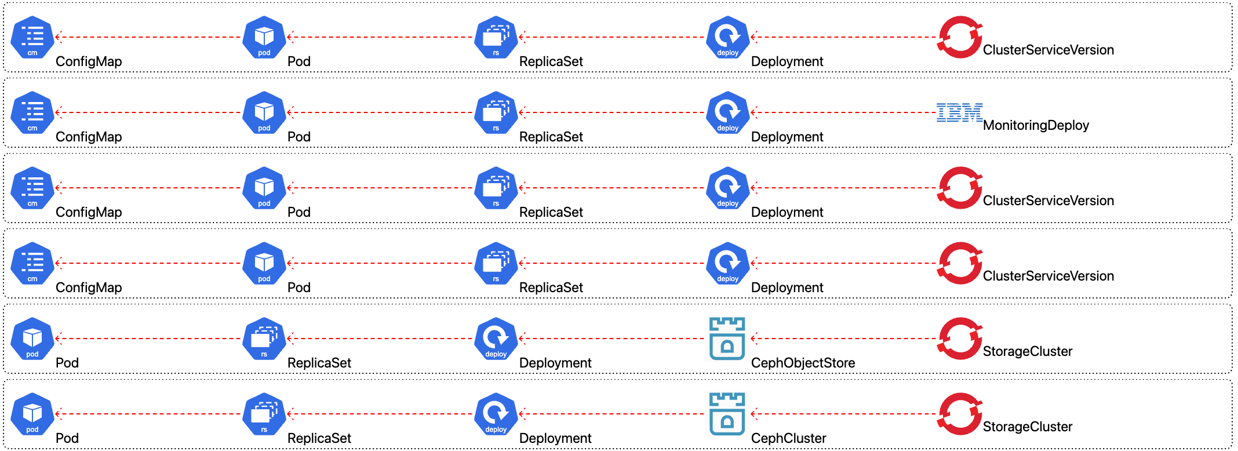
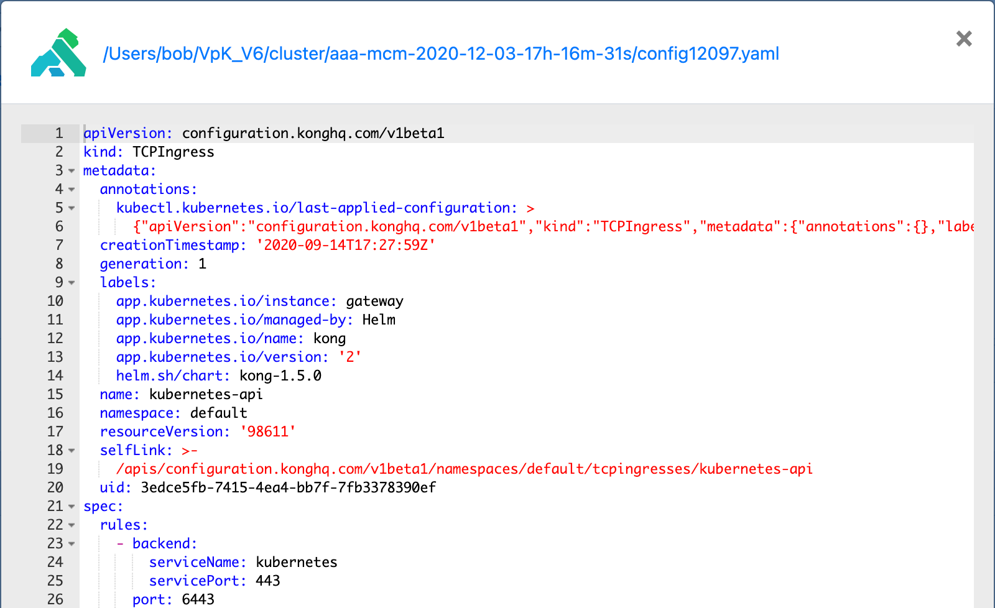
RBAC info, view yaml, ownerRefs, descriptions
OwnerReference chains
Resource description
Color coded views of RBAC
View resource yaml

Slide 8
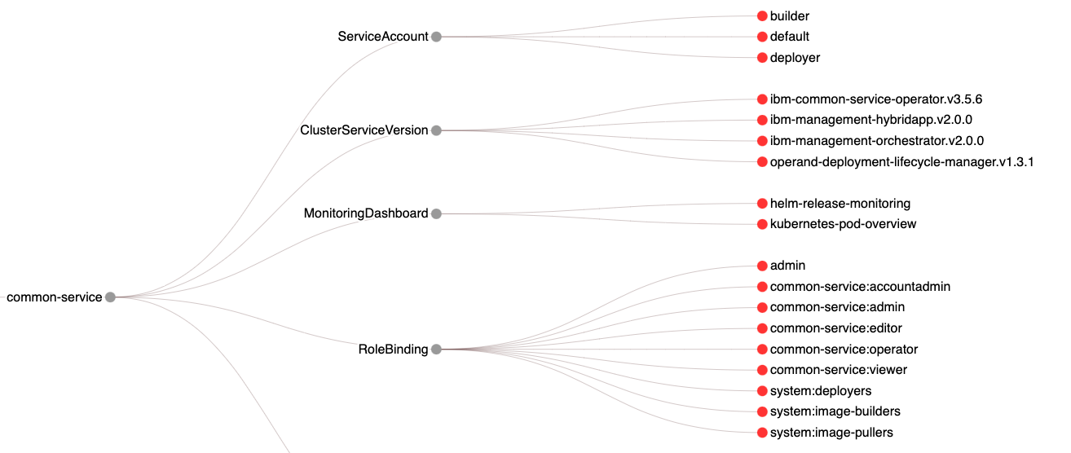
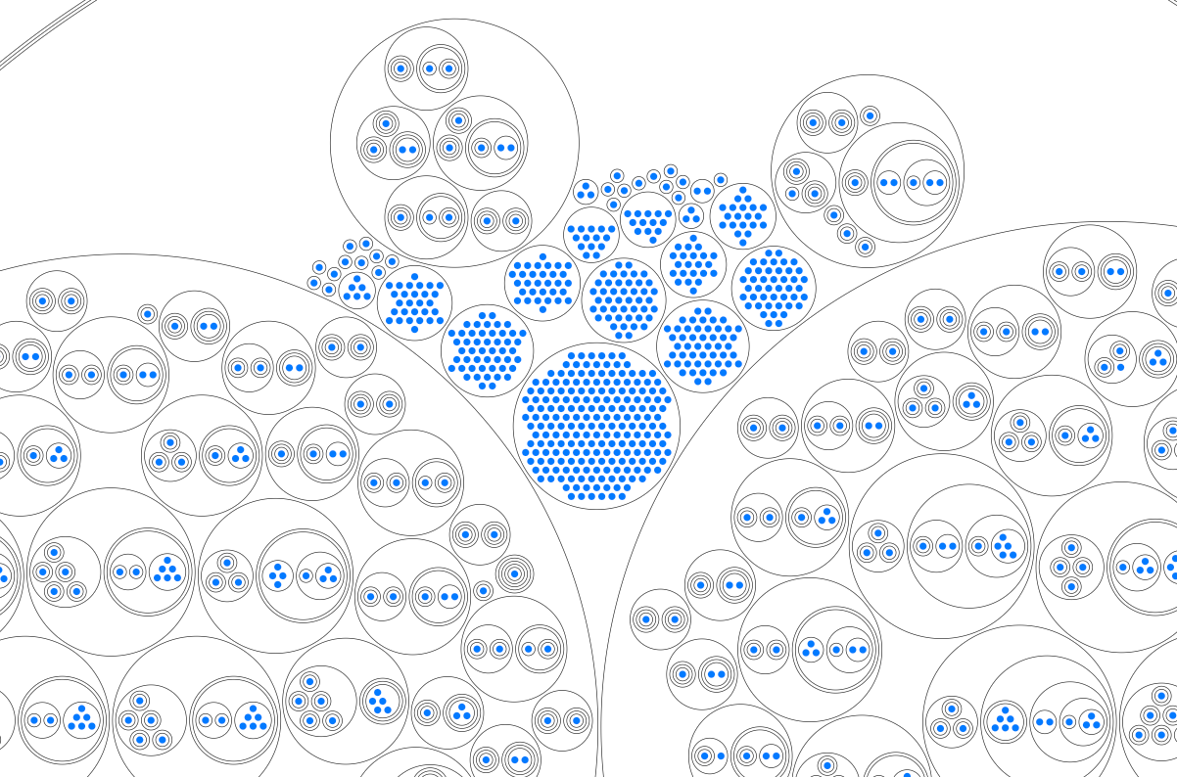
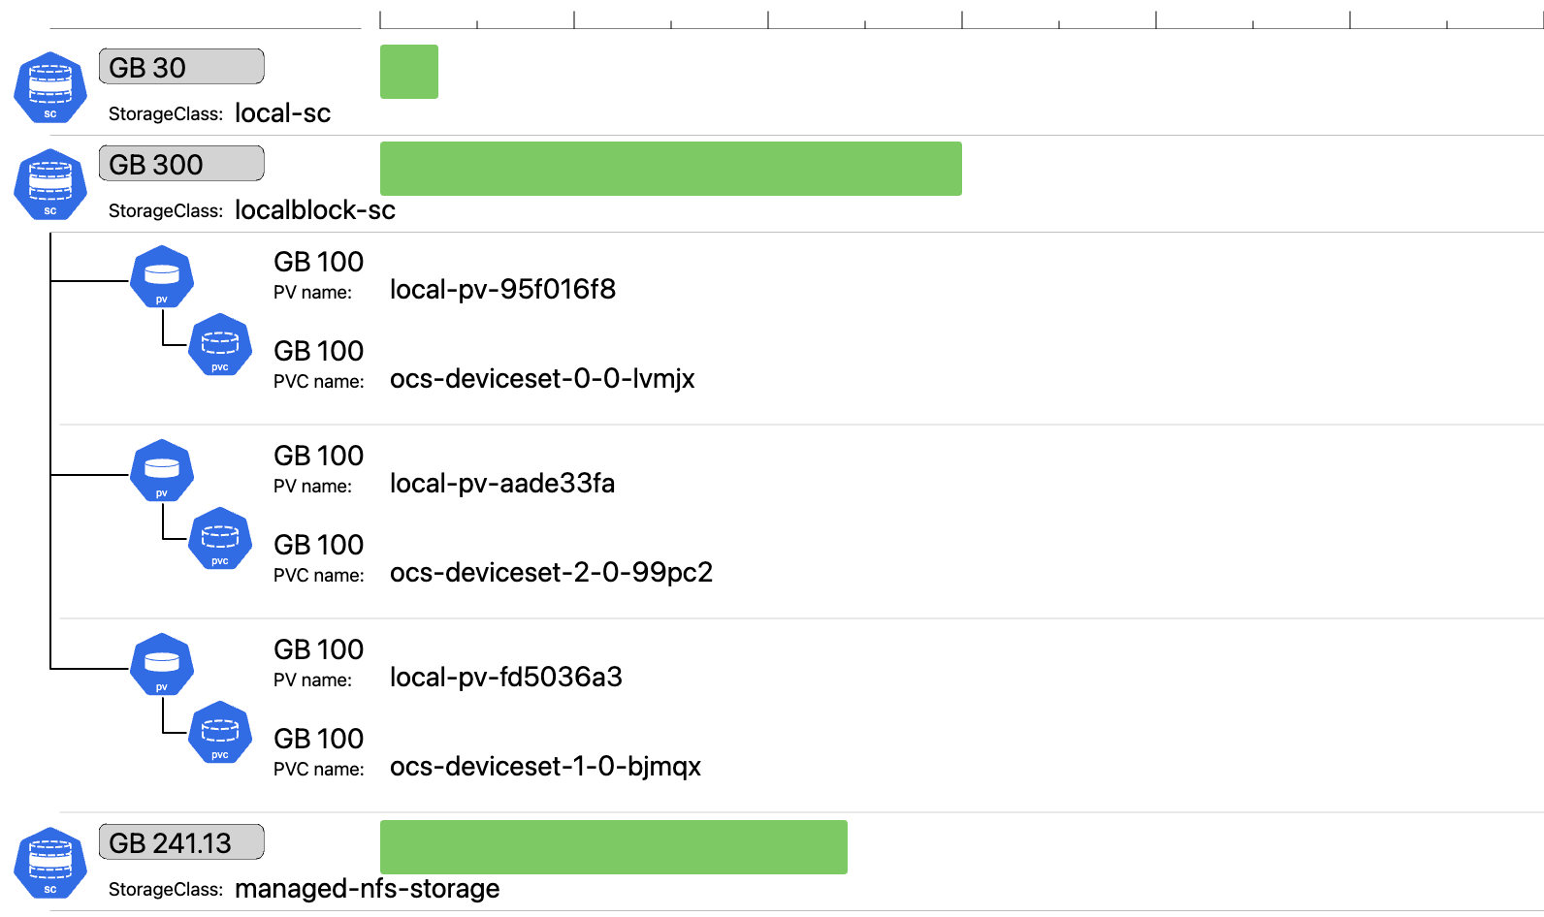
Multiple graphics of K8 resources
Hierarchy diagrams
CirclePack Diagrams
Drill-down
Bar charts

Slide 9
Getting started
VpK software is open source and free.
Vpk requires node.js along with package manager npm or yarn.
VpK software is available from https://github.com/k8debug/vpk.git Clone the repo or download the zip. If using zip file, unzip file into a directory.
Change to the directory where the software is cloned or copied and install the required node packages by running: npm install
Start the software by running command: npm start

Slide 10






Visual parsed Kubernetes
“Visualizing what’s inside of Kubernetes”
VpK software: Open-source and free, available at: https://github.com/k8debug/vpk
Music: Creative Minds from Bensound.com at: https://www.bensound.com
Icons that are used to help identify resources are the properties of the associated companies or organizations. Any errors or omissions in providing attribution is merely an accident and does not imply any ownership.
Kubernetes Community
https://github.com/kubernetes/community/tree/master/icons
Red Hat, Inc.
IBM, Inc.
Rook Authors
Kong Inc.

Slide 11
Visual parsed Kubernetes
“Visualizing what’s inside of Kubernetes”
Interactive schematic of
deployed workload

Slide 12
VpK
Visual parsed Kubernetes
“Visualizing what’s inside of Kubernetes”
Getting started

Slide 13
VpK
Visual parsed Kubernetes
“Visualizing what’s inside of Kubernetes”
User Interface

Slide 14
VpK
Visual parsed Kubernetes
“Visualizing what’s inside of Kubernetes”
Overview and general use

Slide 15
VpK
Visual parsed Kubernetes
“Visualizing what’s inside of Kubernetes”
Custom cross references, x-refs

Slide 16
VpK
Visual parsed Kubernetes
“Visualizing what’s inside of Kubernetes”
Snapshot creation

Slide 17
VpK
Visual parsed Kubernetes
“Visualizing what’s inside of Kubernetes”
Schematics

Slide 18
VpK
Visual parsed Kubernetes
“Visualizing what’s inside of Kubernetes”
Graphic View

Slide 19
VpK
Visual parsed Kubernetes
“Visualizing what’s inside of Kubernetes”
Table View

Slide 20
VpK
Visual parsed Kubernetes
“Visualizing what’s inside of Kubernetes”
Security

Slide 21
VpK
Visual parsed Kubernetes
“Visualizing what’s inside of Kubernetes”
Storage

Slide 22
VpK
Visual parsed Kubernetes
“Visualizing what’s inside of Kubernetes”
Cluster

Slide 23
VpK
Visual parsed Kubernetes
“Visualizing what’s inside of Kubernetes”
OwnerRef Links

